Slide 1
State of black women in California
Sierra Health Foundation
March 14, 2018

Slide 2
Spoken Word Presentation
CoCo Blossom

Slide 3
Welcome
Kellie Todd Griffin
President, Sistallect, Inc.

Slide 4
Special Guests Remarks
Chet Hewitt
President & CEO
Sierra Health Foundation
Senator Holly Mitchell
30th State Senate District

Slide 5
Agenda
9:25 a.m. Subject Matter Expert Panel – Hosted by Sandra O. Poole
        Health & Wellness – Dr. Elaine Batchlor, President & CEO, Martin Luther King Community Hospital
        Violence & Safety – Karen Earl, President & CEO, Jenesse
        Poverty & Opportunities – Stephanie Bray, President & CEO, United Way of Greater Sacramento Region
        Political Participation – Kimberly Ellis, Advocate & Former Executive Director, Emerge CA
        Employment & Earnings – Sandra Davis Houston, Vice President of Human Resources, Dignity Health
        Work & Family – Dr. Robin Carter, Dean of Social Work, Interim Executive Director of Diversity of Inclusion and Diversity
11:00 a.m. First Breakout
        Health & Wellness
        Violence & Safety
        Poverty & Opportunities
12:30 p.m. Lunch, Review & Networking

Slide 6
Agenda (cont’d)
1:00 p.m. Kathy Williamson Host a Conversation on Leading through Change – Past to Present
          Elika Bernard, Black Women United
          Dezie Woods-Jones, Black Women Organized for Political Action
2:00 p.m. First Breakout Report Out
2:45 p.m. Second Break Out
        Political Participation
        Employment & Earnings
        Work & Family
4:15 p.m. Second Breakout Review
4:45 p.m. Second Breakout Report Out
5:45 p.m. Closing Remarks
6:00 p.m. Reception – Pearl On The River, 1379 Garden Hwy, Sacramento, CA 95833

Slide 7
Panel Presentations
Sandra O. Poole
Principal
Poole Consultants

Slide 8
Improving Health for African American Women
Elaine Batchlor, MD, MPH
Chief Executive Officer
Martin Luther King, Jr. Community Hospital

Slide 9
Health Disparities for African American Women

Slide 10
Health Disparities
Life Expectancy
  Latina 83.1 years
  White 80.8 years
  African American 76.8 years

Slide 11
Health Disparities
Diabetes
  Incidence is more than double
  12.7% vs 6.1%
Heart Disease
  Mortality rate is 33% higher
Stroke
  Mortality rate is 31% higher

Slide 12
Health Disparities
Breast Cancer
  12.5% less likely to develop breast cancer
  Mortality rate 56% higher
  Although mammogram rates are similar, African American Women suffer disproportionately from the most aggressive form of breast cancer – triple negative
Cervical Cancer
  Mortality rate twice as high
Colon Cancer
  35-40% higher mortality

Slide 13
Health Disparities
Maternal Health
  3-4 times more likely to die of complications from pregnancy
  Serena Williams experience
  Low birth weight rate is 68% higher
Sexually Transmitted Diseases
    50% of reported Chlamydia & Syphilis
    75% of reported Gonorrhea
Obesity
  Prevalence is 58% higher
  57% vs 36%
  4 out of 5 are overweight

Slide 14
Health Disparities
Mental Health Conditions
  10% more likely to report serious psychological distress
  Double the rate of depression
  Dementia

Slide 15
Factors Contributing to Health Disparities

Slide 16
Contributing Factors
Social and Environmental Factors
  Poverty (double the rate)
  Access to healthy food
  Violence
  Space to exercise
  Education/health literacy
  Housing
  Transportation

Slide 17
Contributing Factors
Personal Behaviors
  Poor nutrition
  Lack of exercise
  Substance abuse (smoking, drinking, other)
  Lack of health screening

Slide 18
Contributing Factors
Access to Health Care
  Insurance coverage
  Provider availability
Quality of Health Care
  Lower quality providers
  Personal and institutional biases

Slide 19
Recommendations to Improve Health for African American Women

Slide 20
Recommendations
Address Social and Environmental Factors
  Employment
  Education
  Food availability
  Green spaces
  Safety
  Transportation
  Housing
Encourage healthy behaviors

Slide 21
Recommendations
Improve Health Care Access and Quality
  Ensure sufficient insurance coverage
    Protect insurance expansion under ACA
    Protect coverage for women’s services
    Improve provider payments under Medicaid
    Promote universal coverage
  Expand provider availability in communities of color
    Full scope of integrated services, including primary and specialty care
    Higher quality providers
  Increase diversity of health professionals
  Track provider outcomes by ethnic group

Slide 22
Thank you…

Slide 23
Violence & Safety
Karen Earl
President & CEO
Jenesse

Slide 24


Slide 25
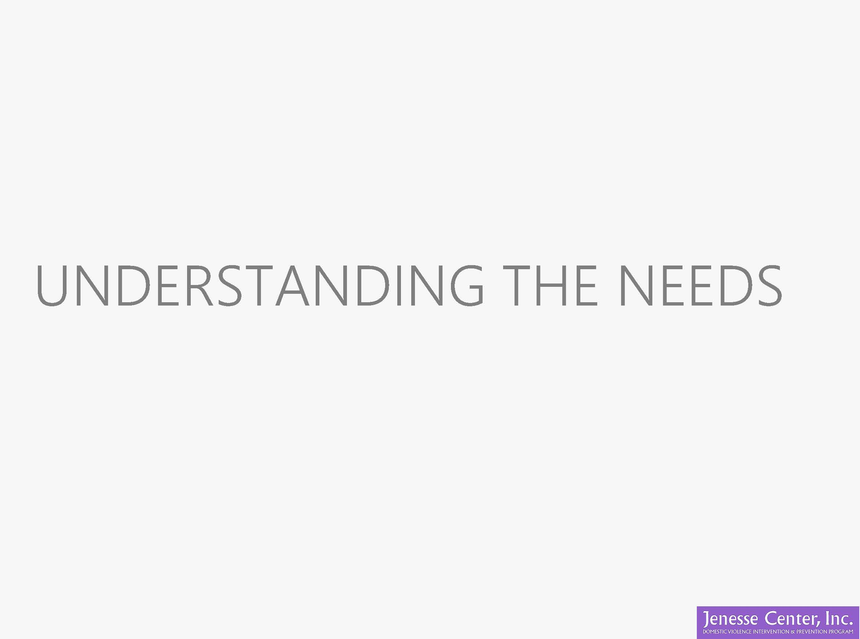

UNDERSTANDING THE NEEDS

Slide 26
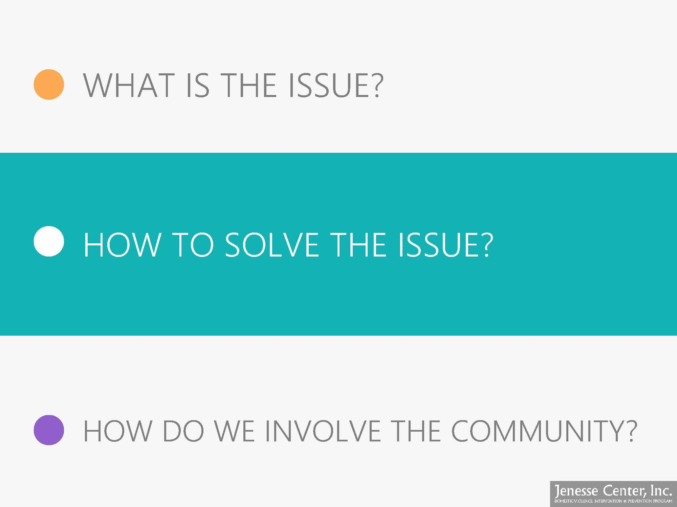

WHAT IS THE ISSUE?
HOW TO SOLVE THE ISSUE?
HOW DO WE INVOLVE THE COMMUNITY?

Slide 27

JENESSE WORKS TO FILL THESE GAPS

Slide 28
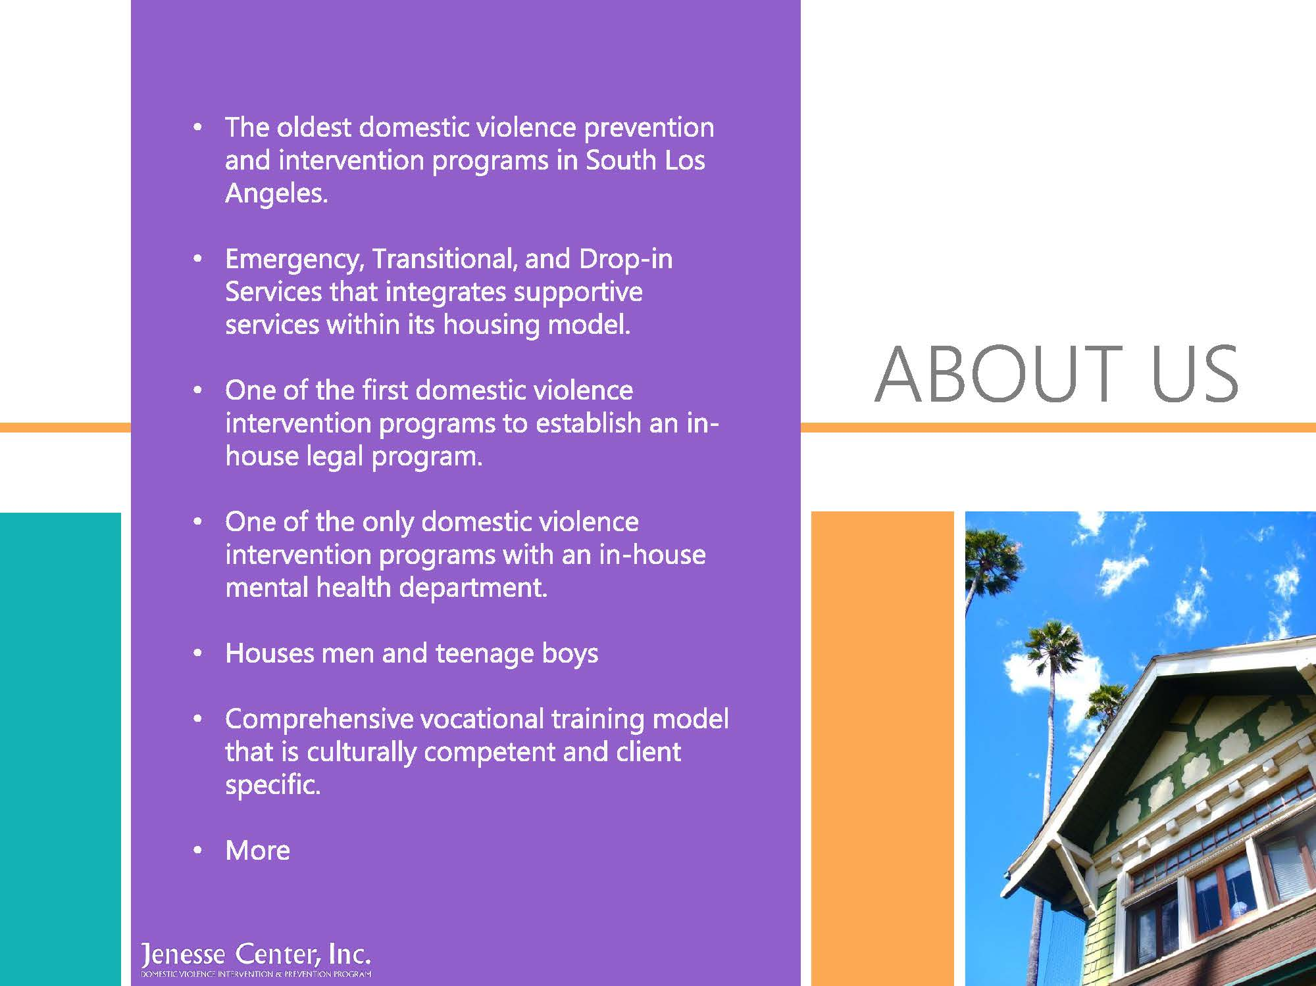






Slide 29


DOMESTIC
WHAT IS
VIOLENCE?
INABILITY
TO LIVE PEACEFULLY
IN YOUR
HOME

Slide 30
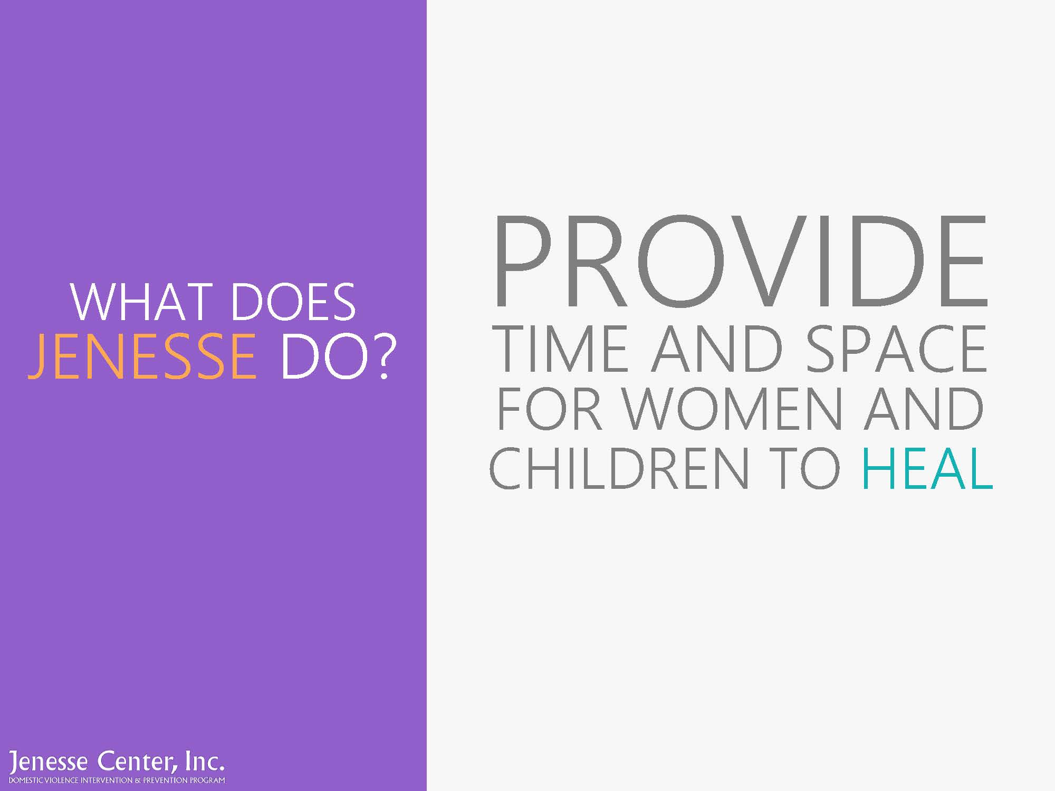
PROVIDE
WHAT DOES
JENESSE DO?
TIME AND SPACE FOR WOMEN AND CHILDREN TO HEAL

Slide 31
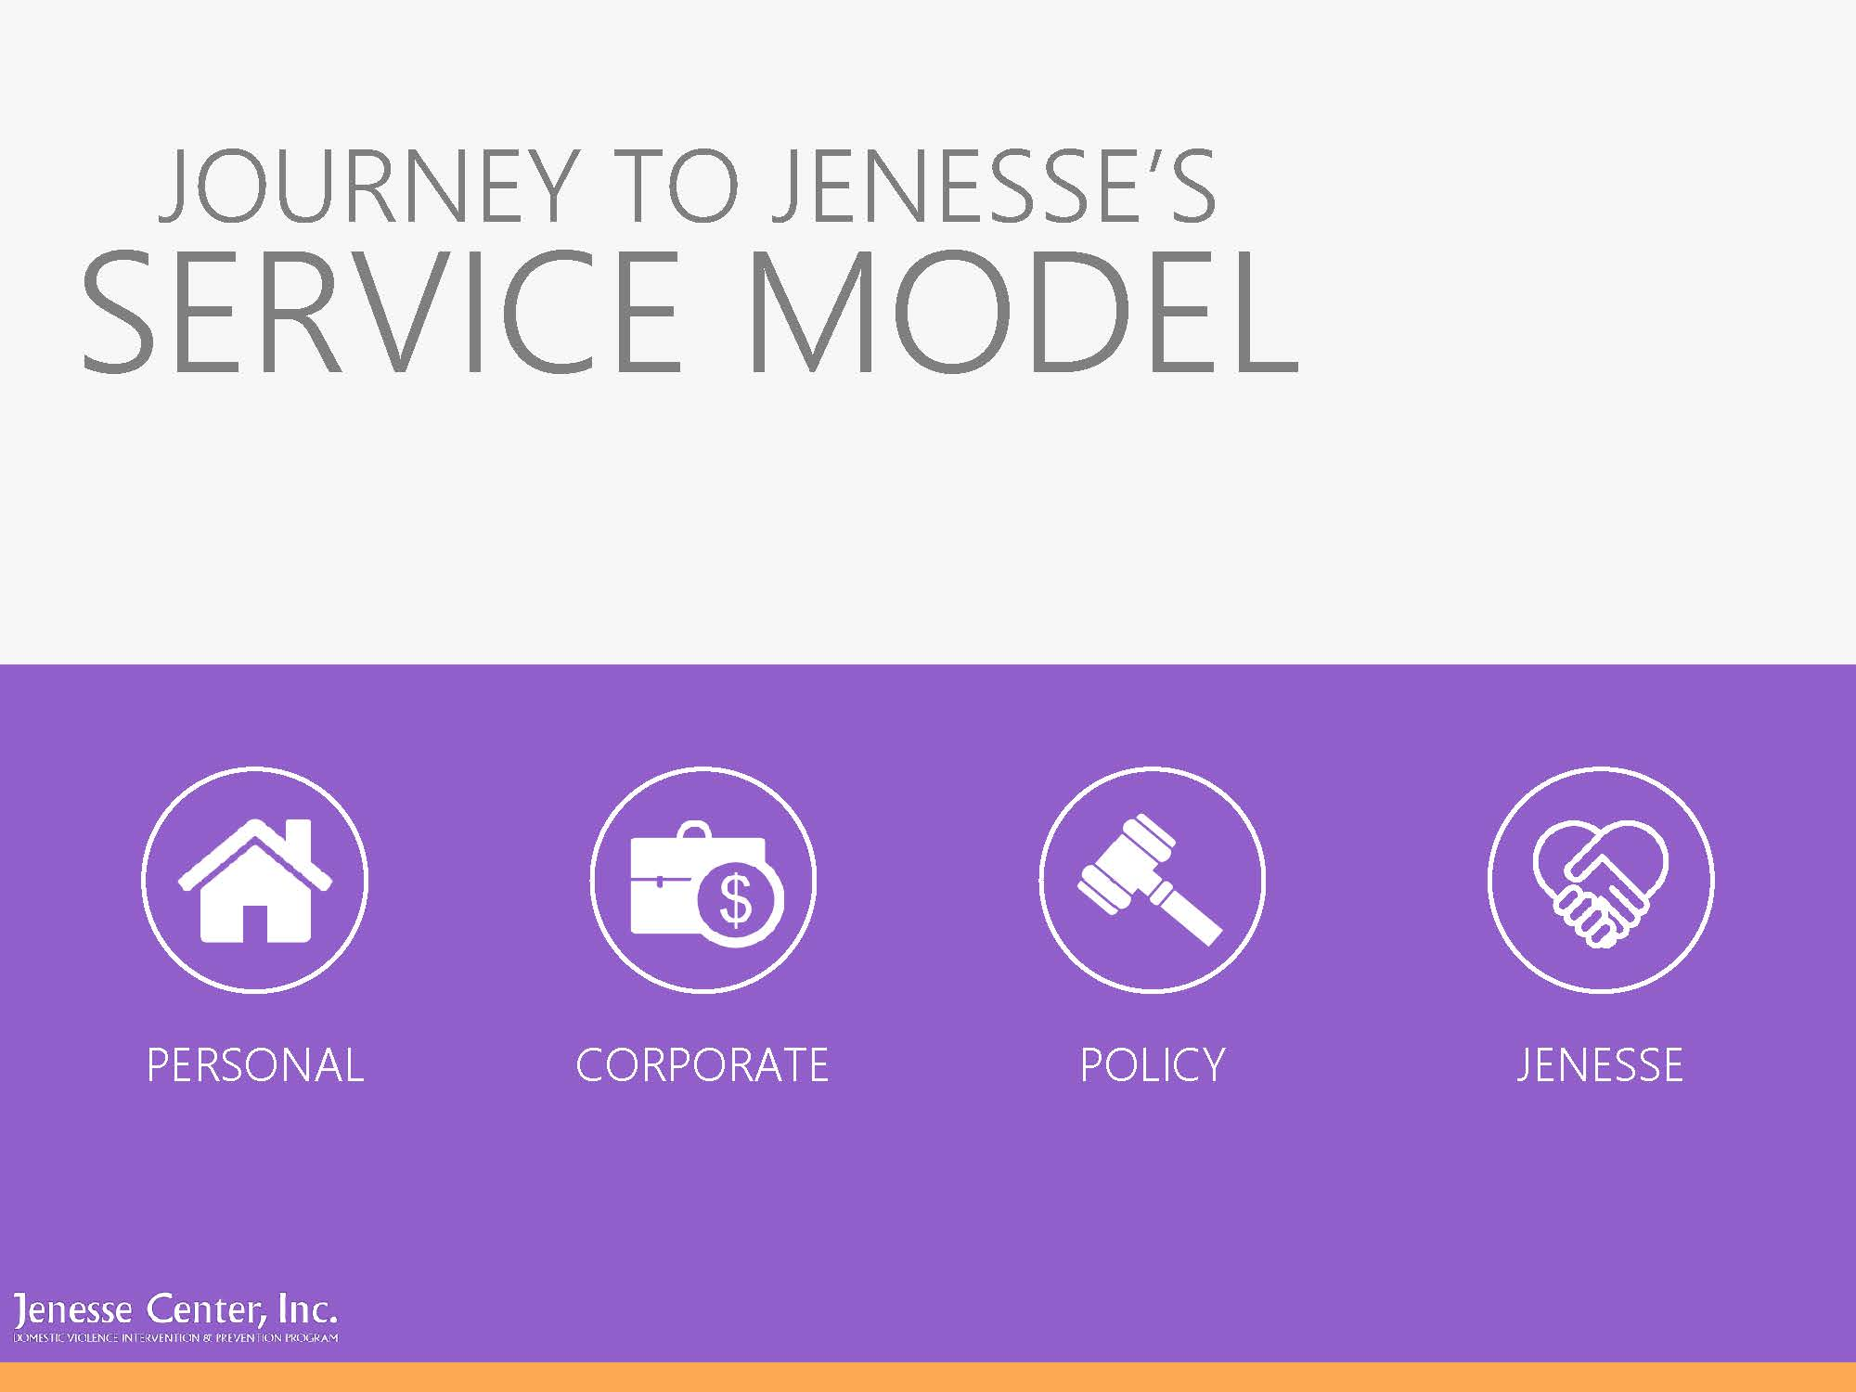




JOURNEY TO JENESSE’S
SERVICE MODEL
PERSONAL
CORPORATE
POLICY
JENESSE

Slide 32
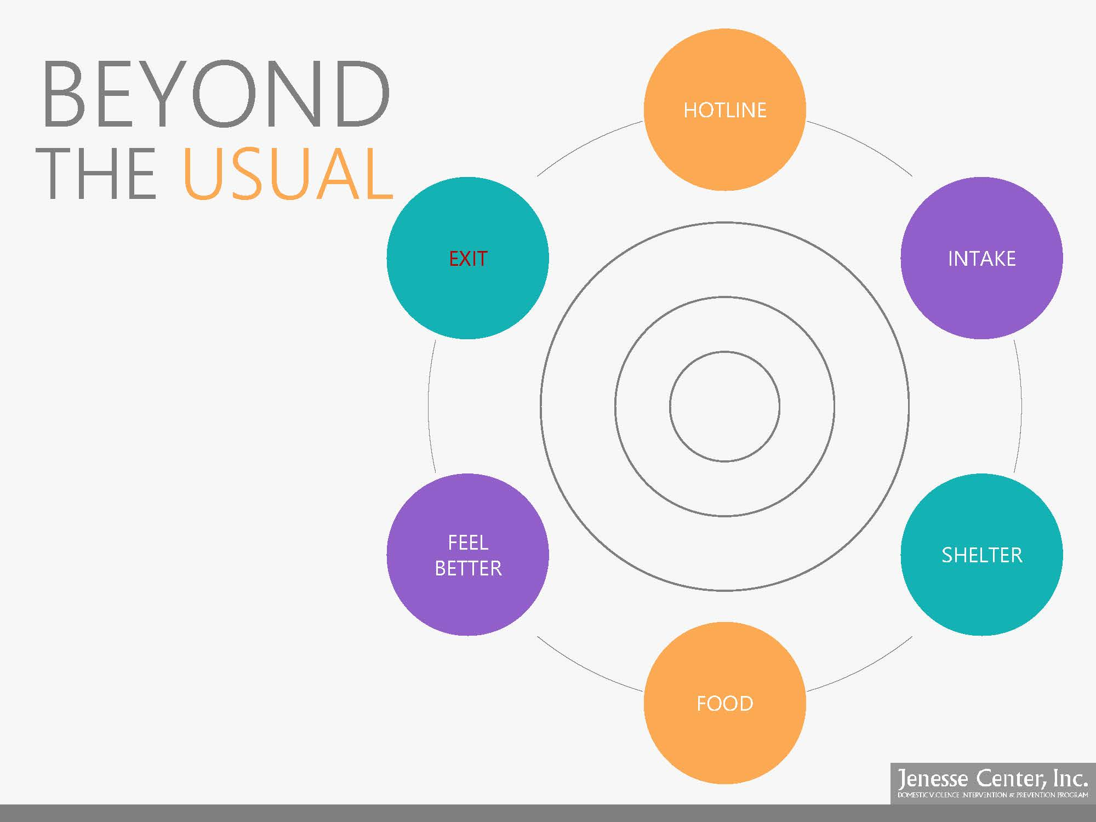
BEYOND
HOTLINE
THE USUAL
EXIT
INTAKE
FEEL BETTER
SHELTER
FOOD

Slide 33
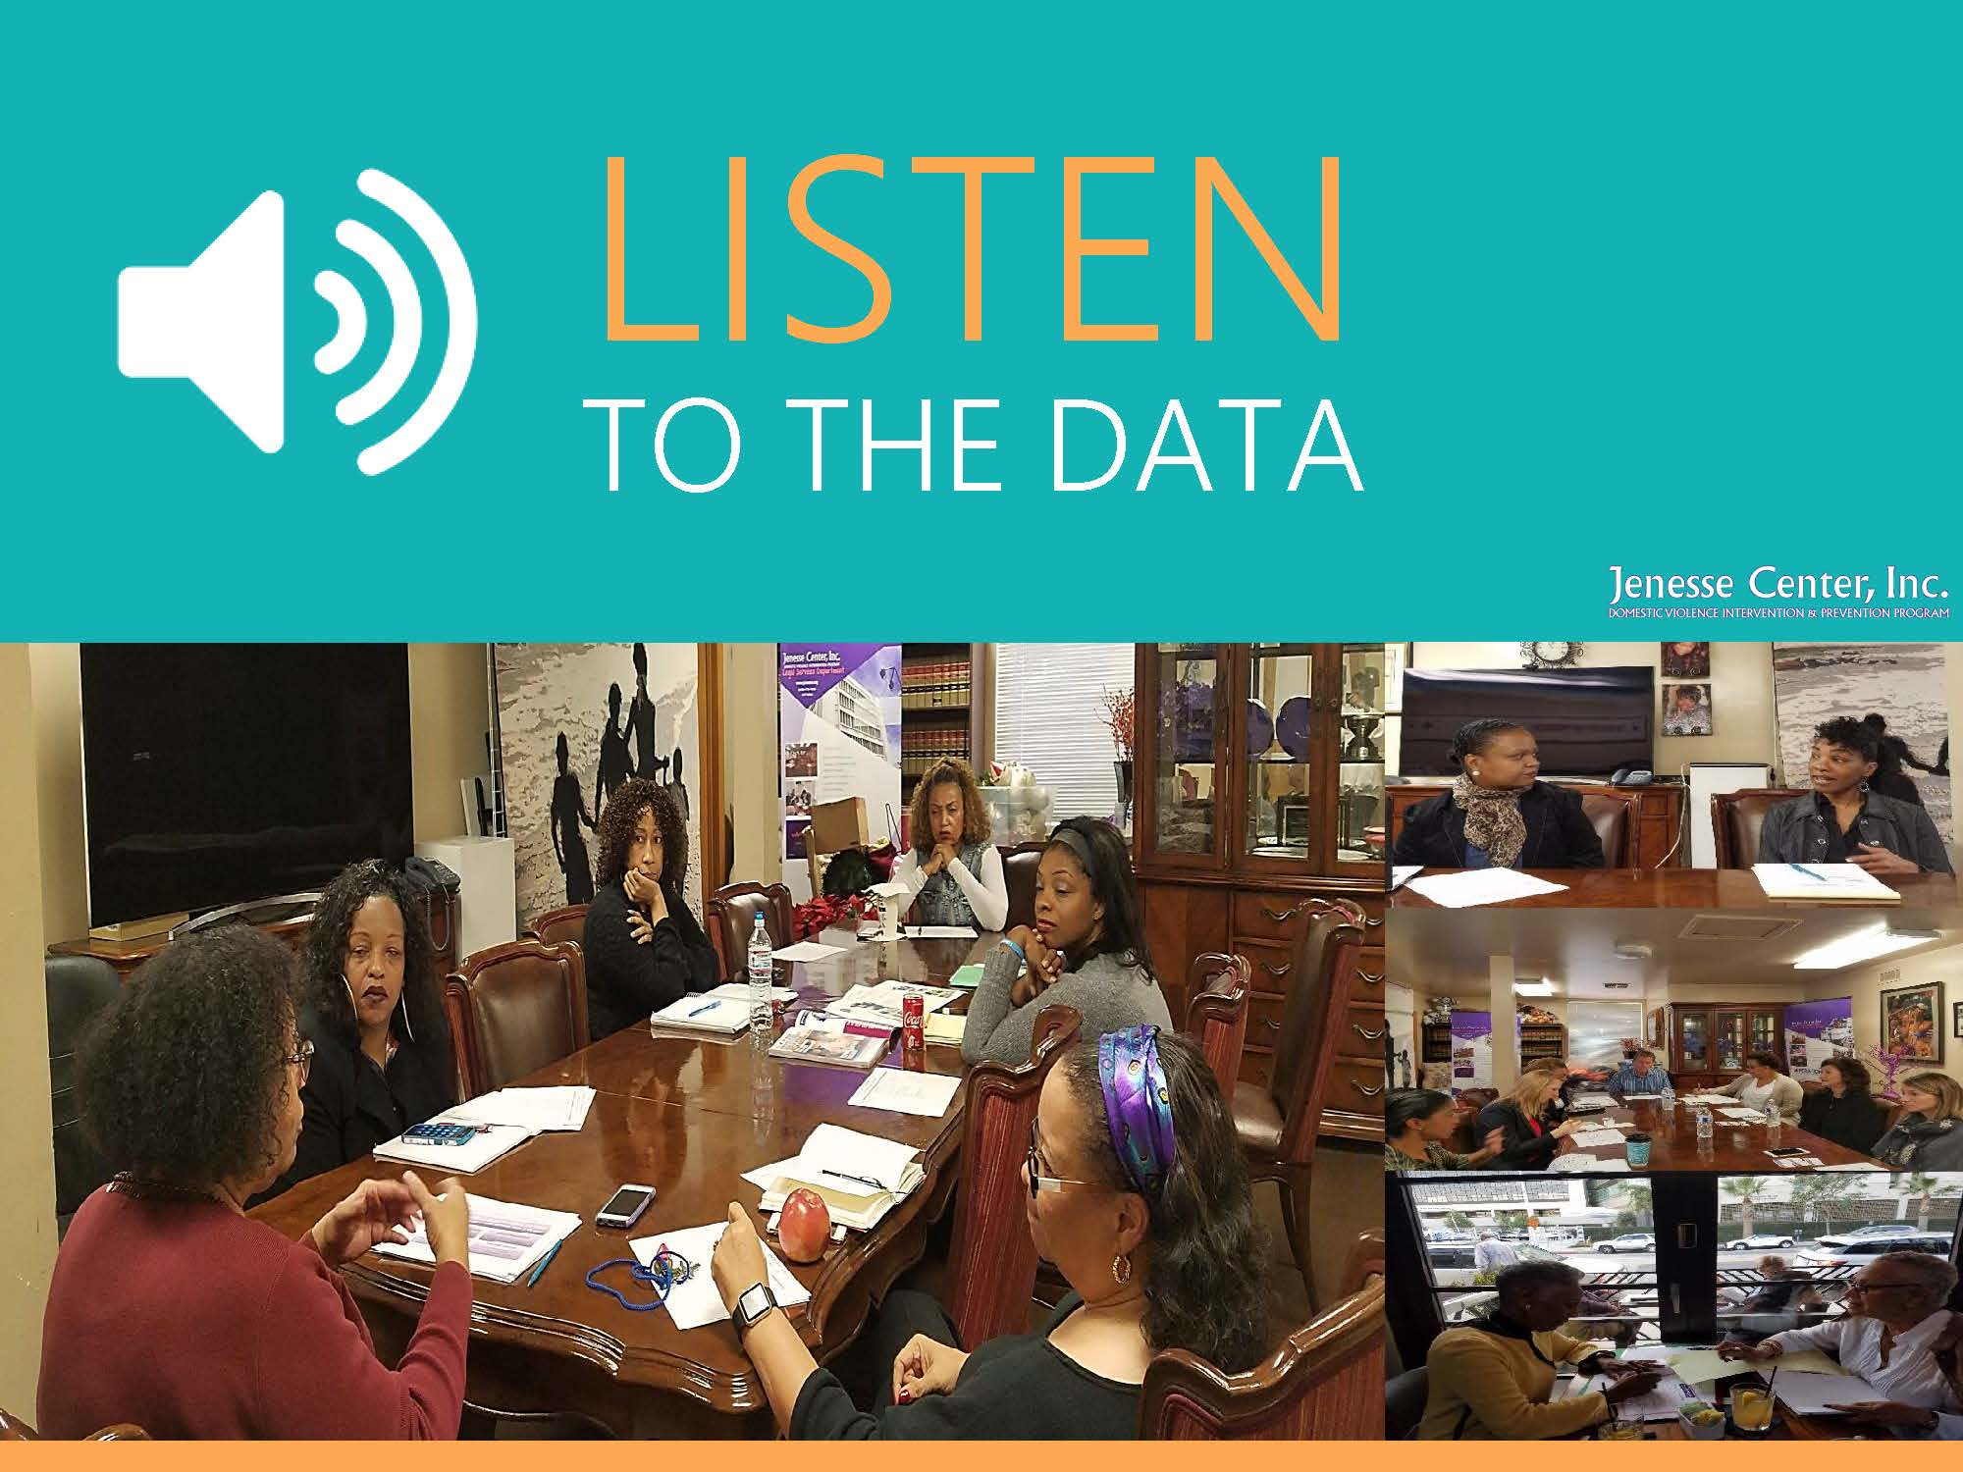

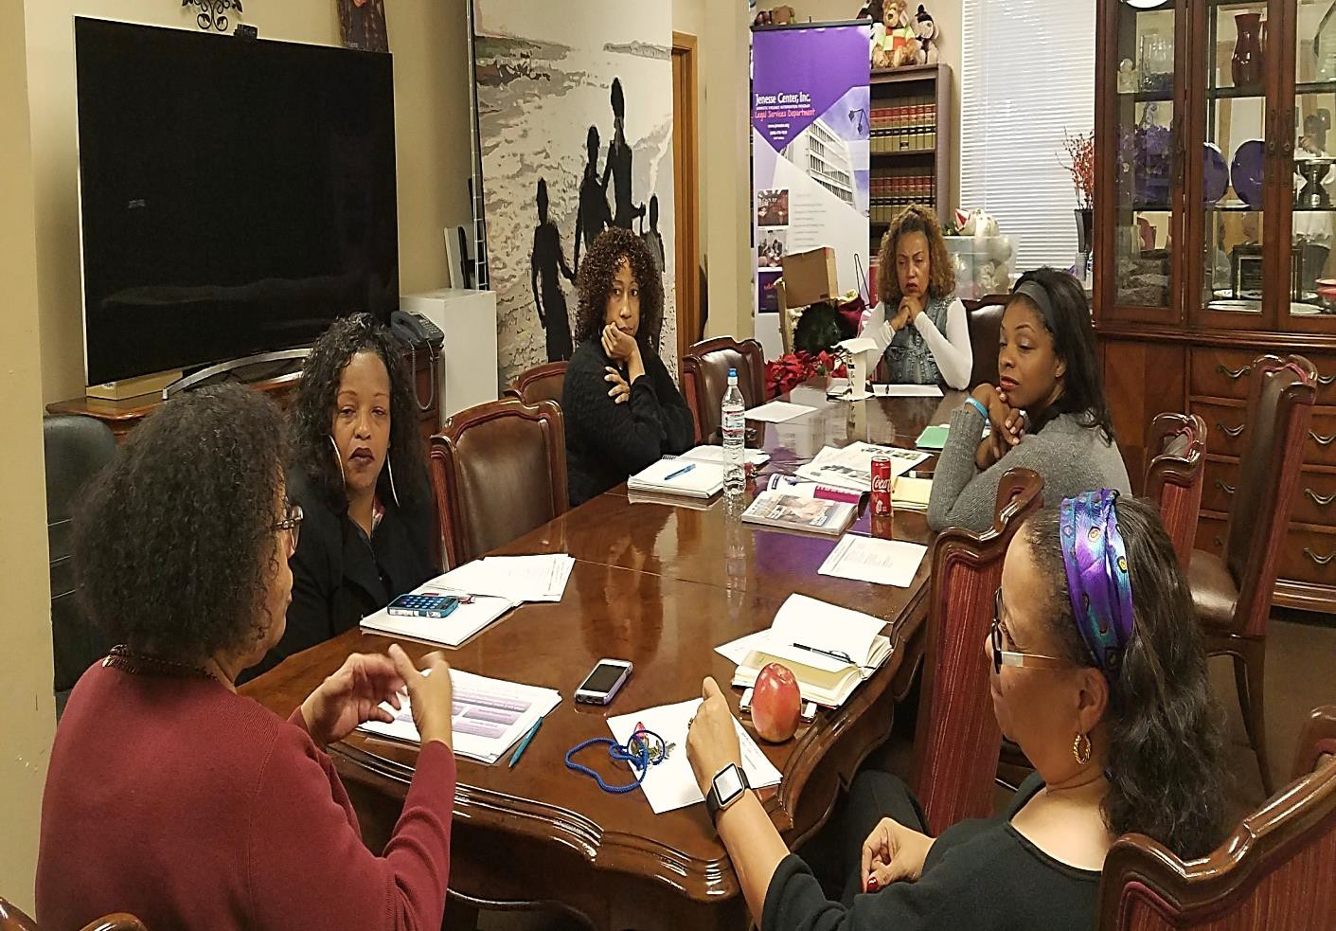
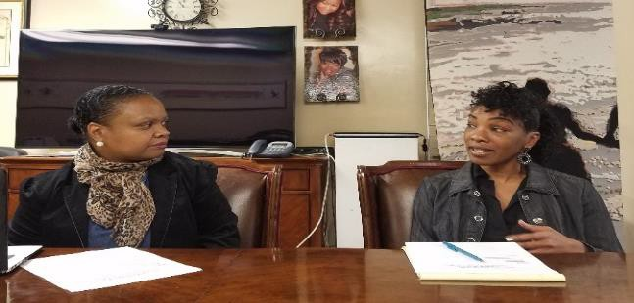
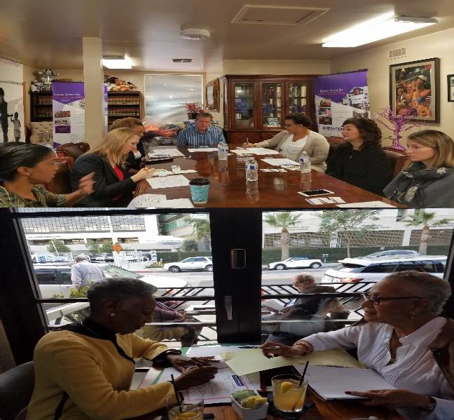
LISTEN
TO THE DATA

Slide 34
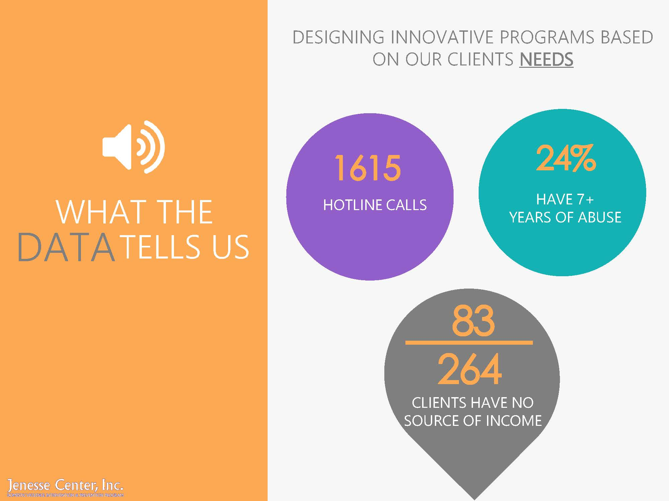





DESIGNING INNOVATIVE PROGRAMS BASED
ON OUR CLIENTS NEEDS
WHAT THE
HOTLINE CALLS
HAVE 7+
YEARS OF ABUSE
DATATELLS US
CLIENTS HAVE NO SOURCE OF INCOME

Slide 35
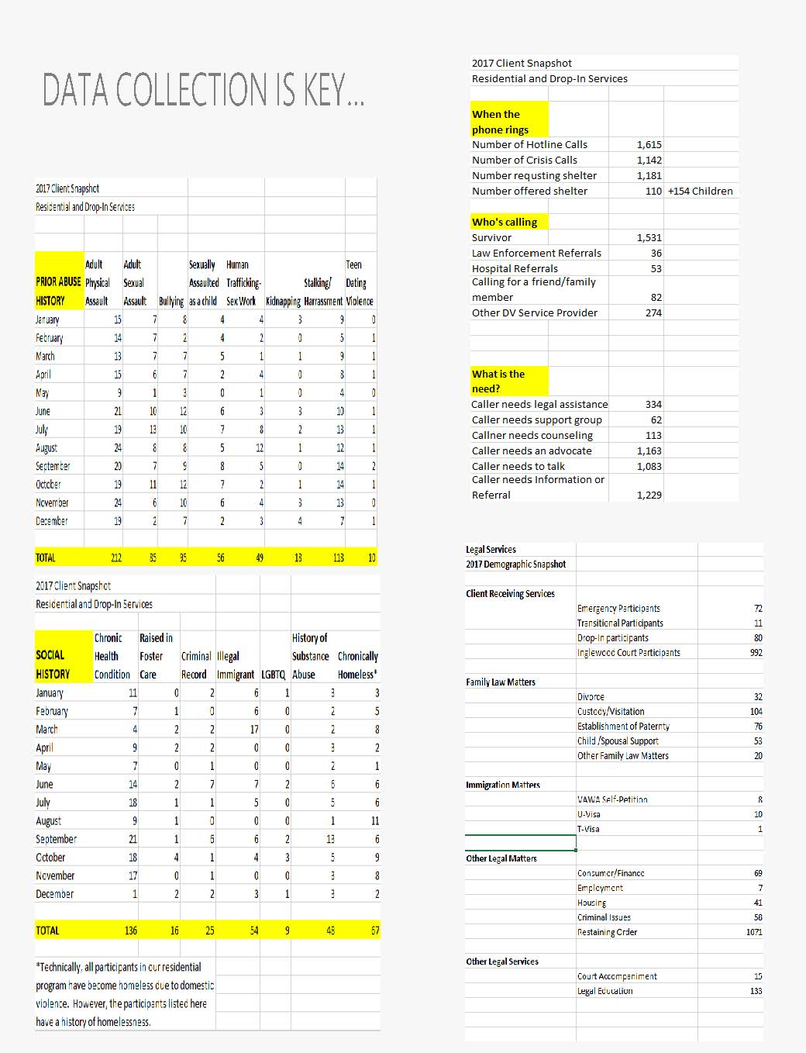
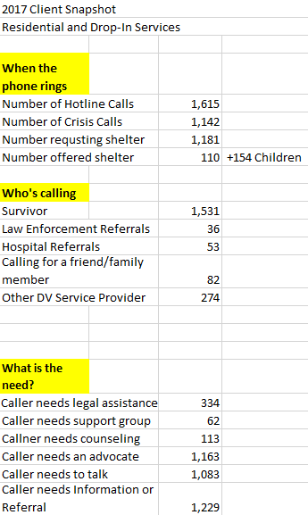
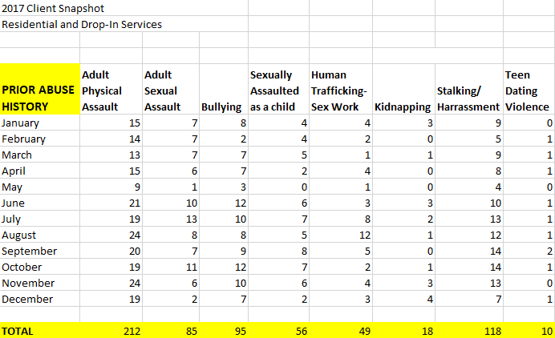
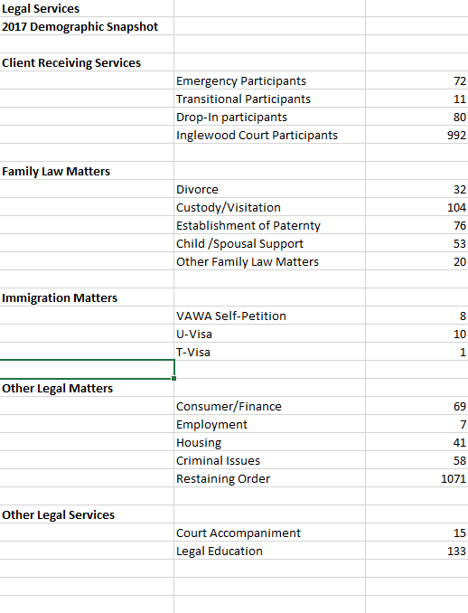
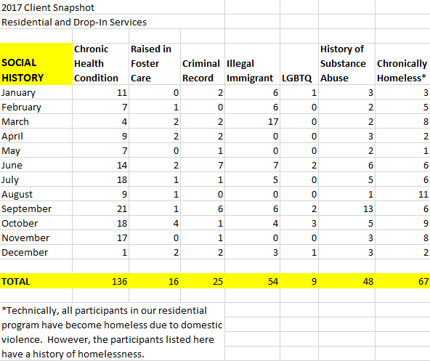
DATA COLLECTION IS KEY…

Slide 36


I CAN’T
“Mom, it’s a girl”
READ
“I’m sad, You didn’t
drink your milk”

Slide 37
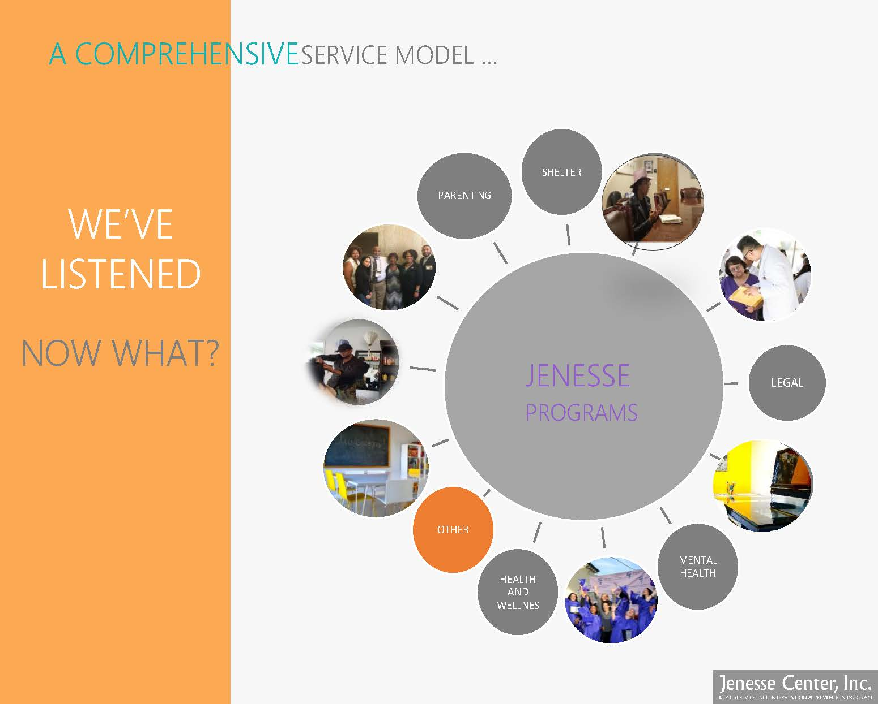
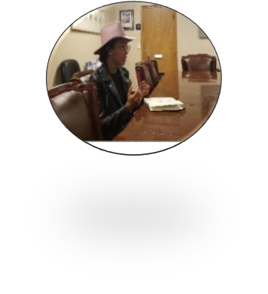
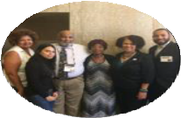

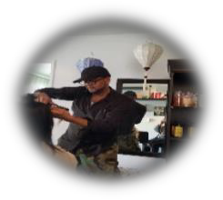



A COMPREHENSIVESERVICE MODEL …
SHELTER
PARENTING
PARTNER- SHIPS
WE’VE
LISTENED
NOW WHAT?
STYLE CENTER
JENESSE
PROGRAMS
LEGAL
EDUCATION
OTHER
MENTAL
HEALTH
HEALTH AND WELLNES

Slide 38

IN HER OWN WORDS…
A LETTER FROM A CLIENT

Slide 39
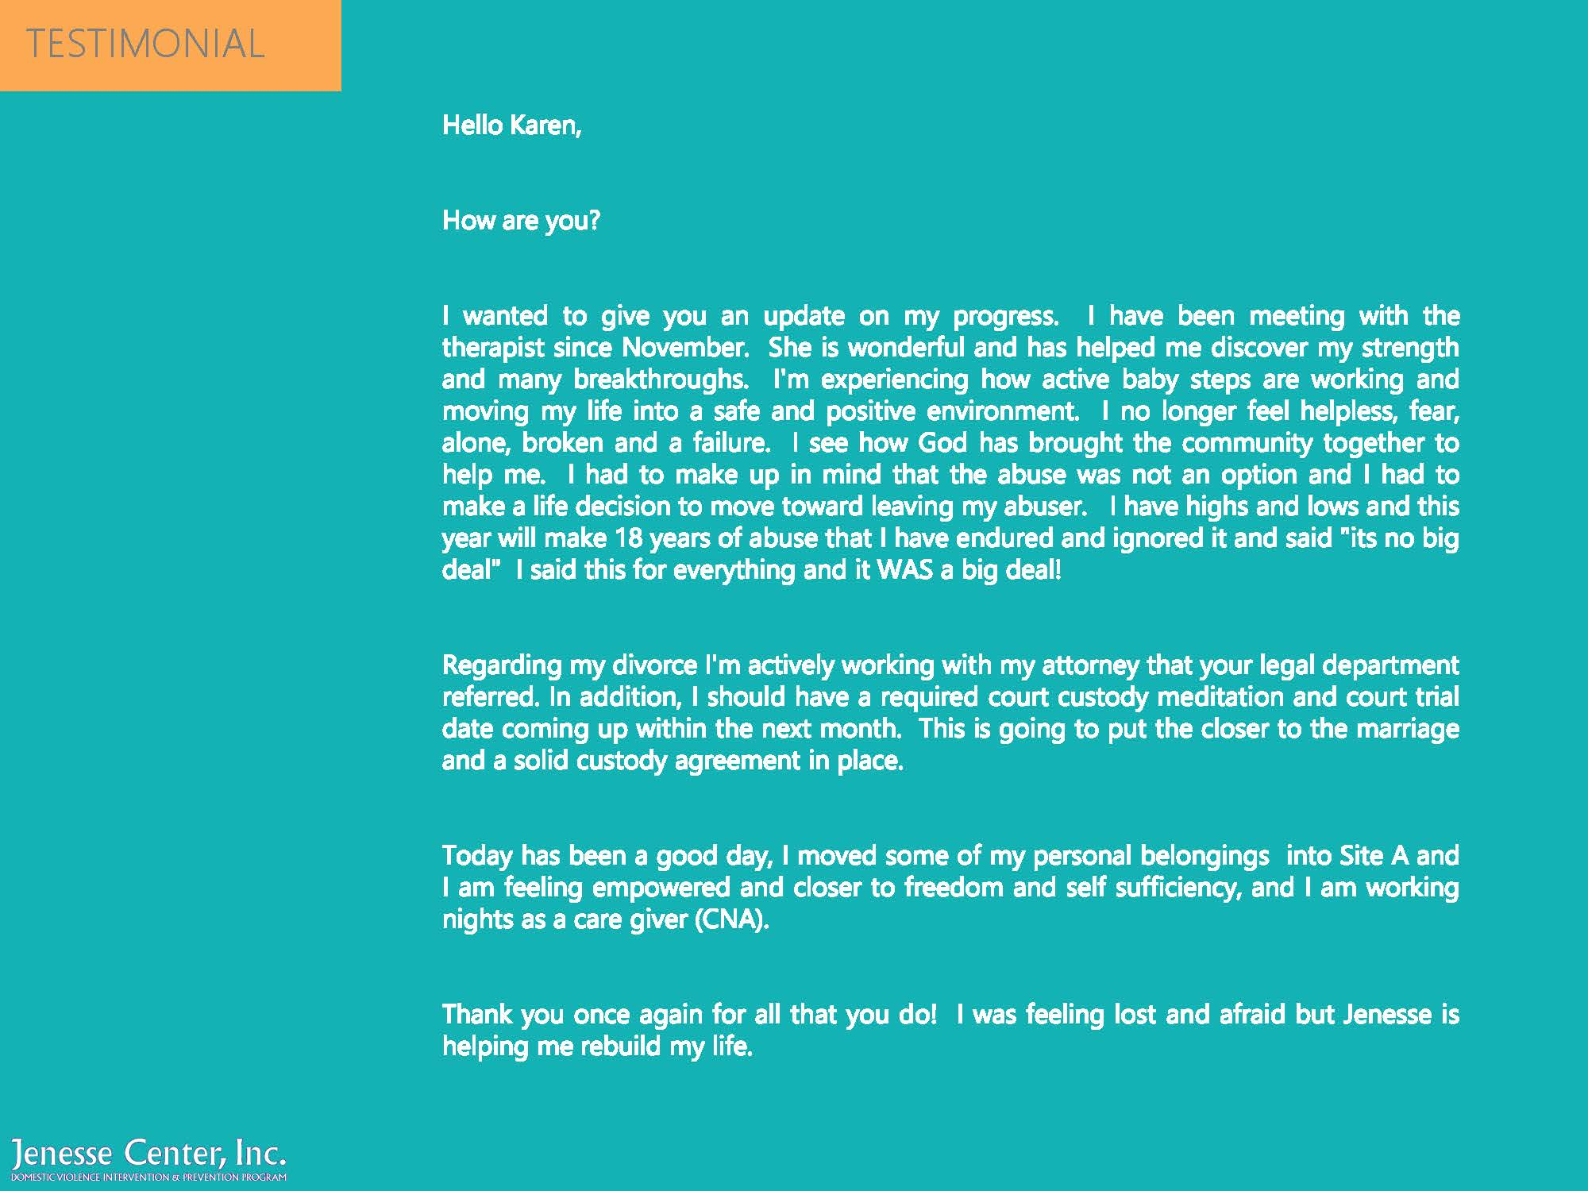

Slide 40
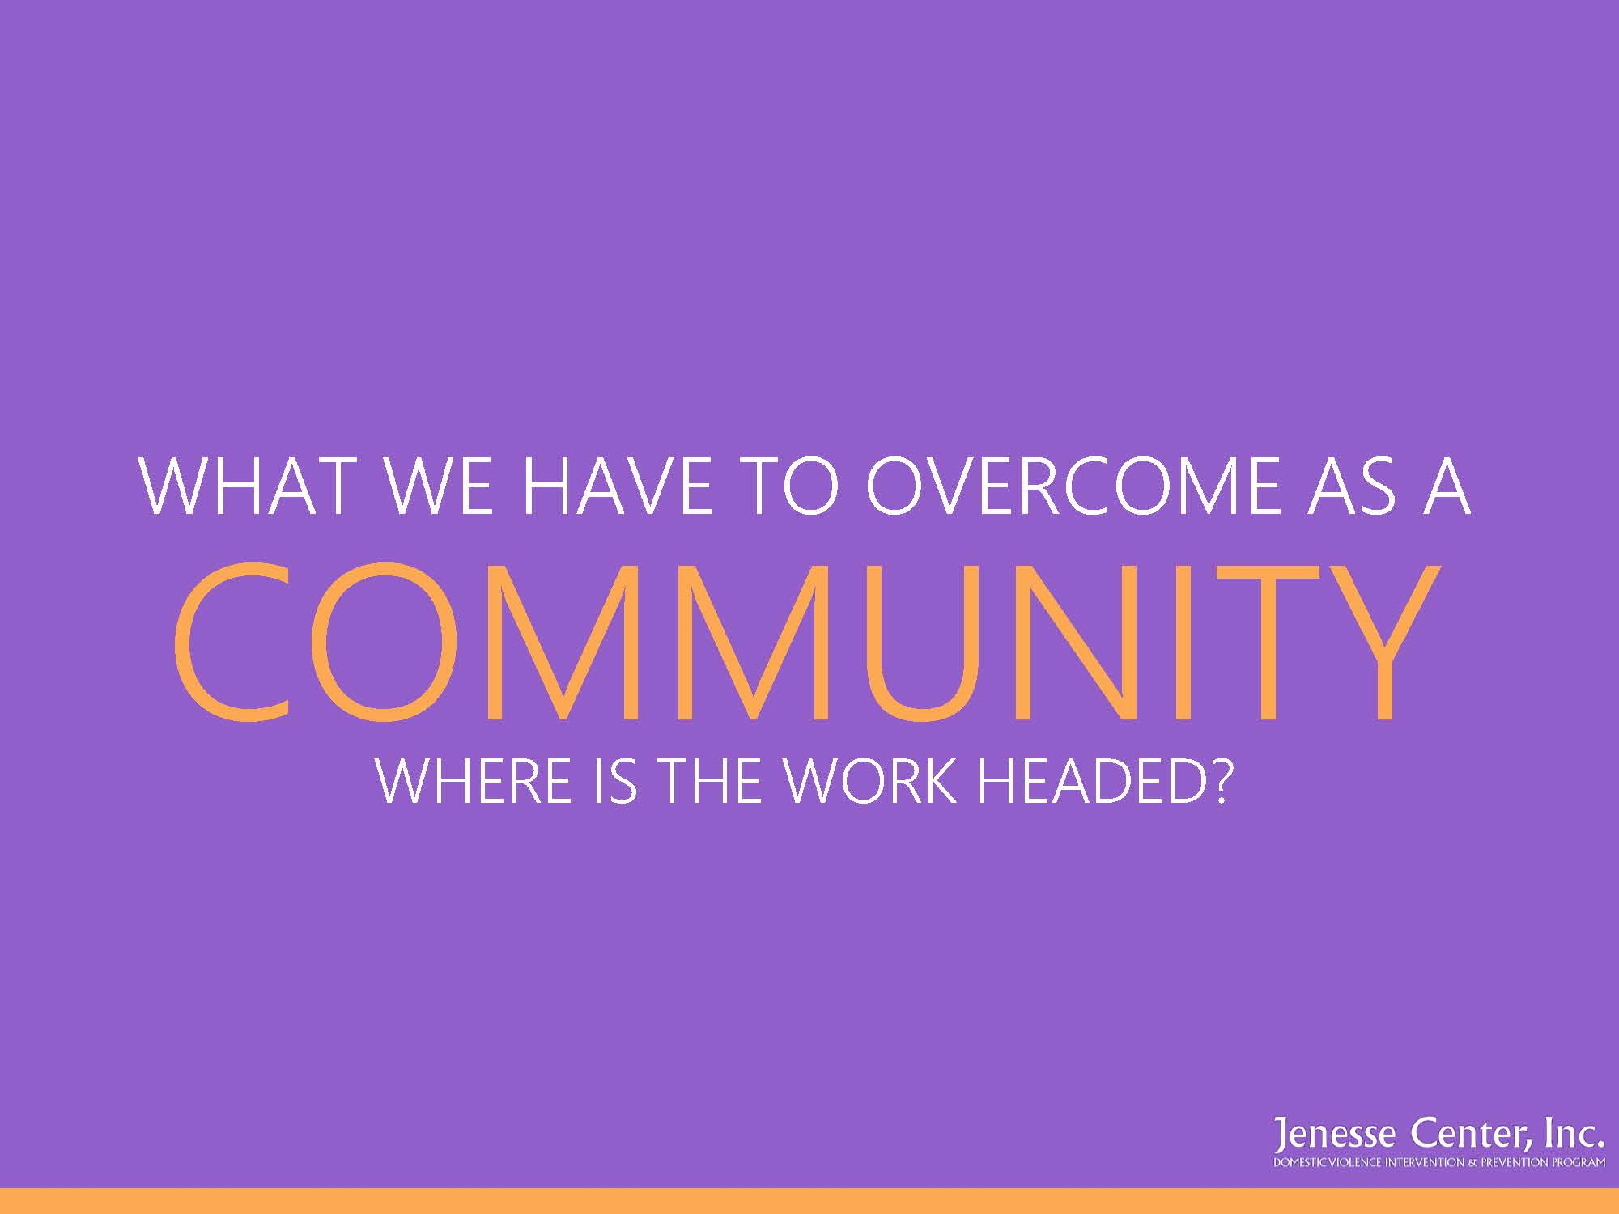
WHAT WE HAVE TO OVERCOME AS A
COMMUNITY
WHERE IS THE WORK HEADED?

Slide 41
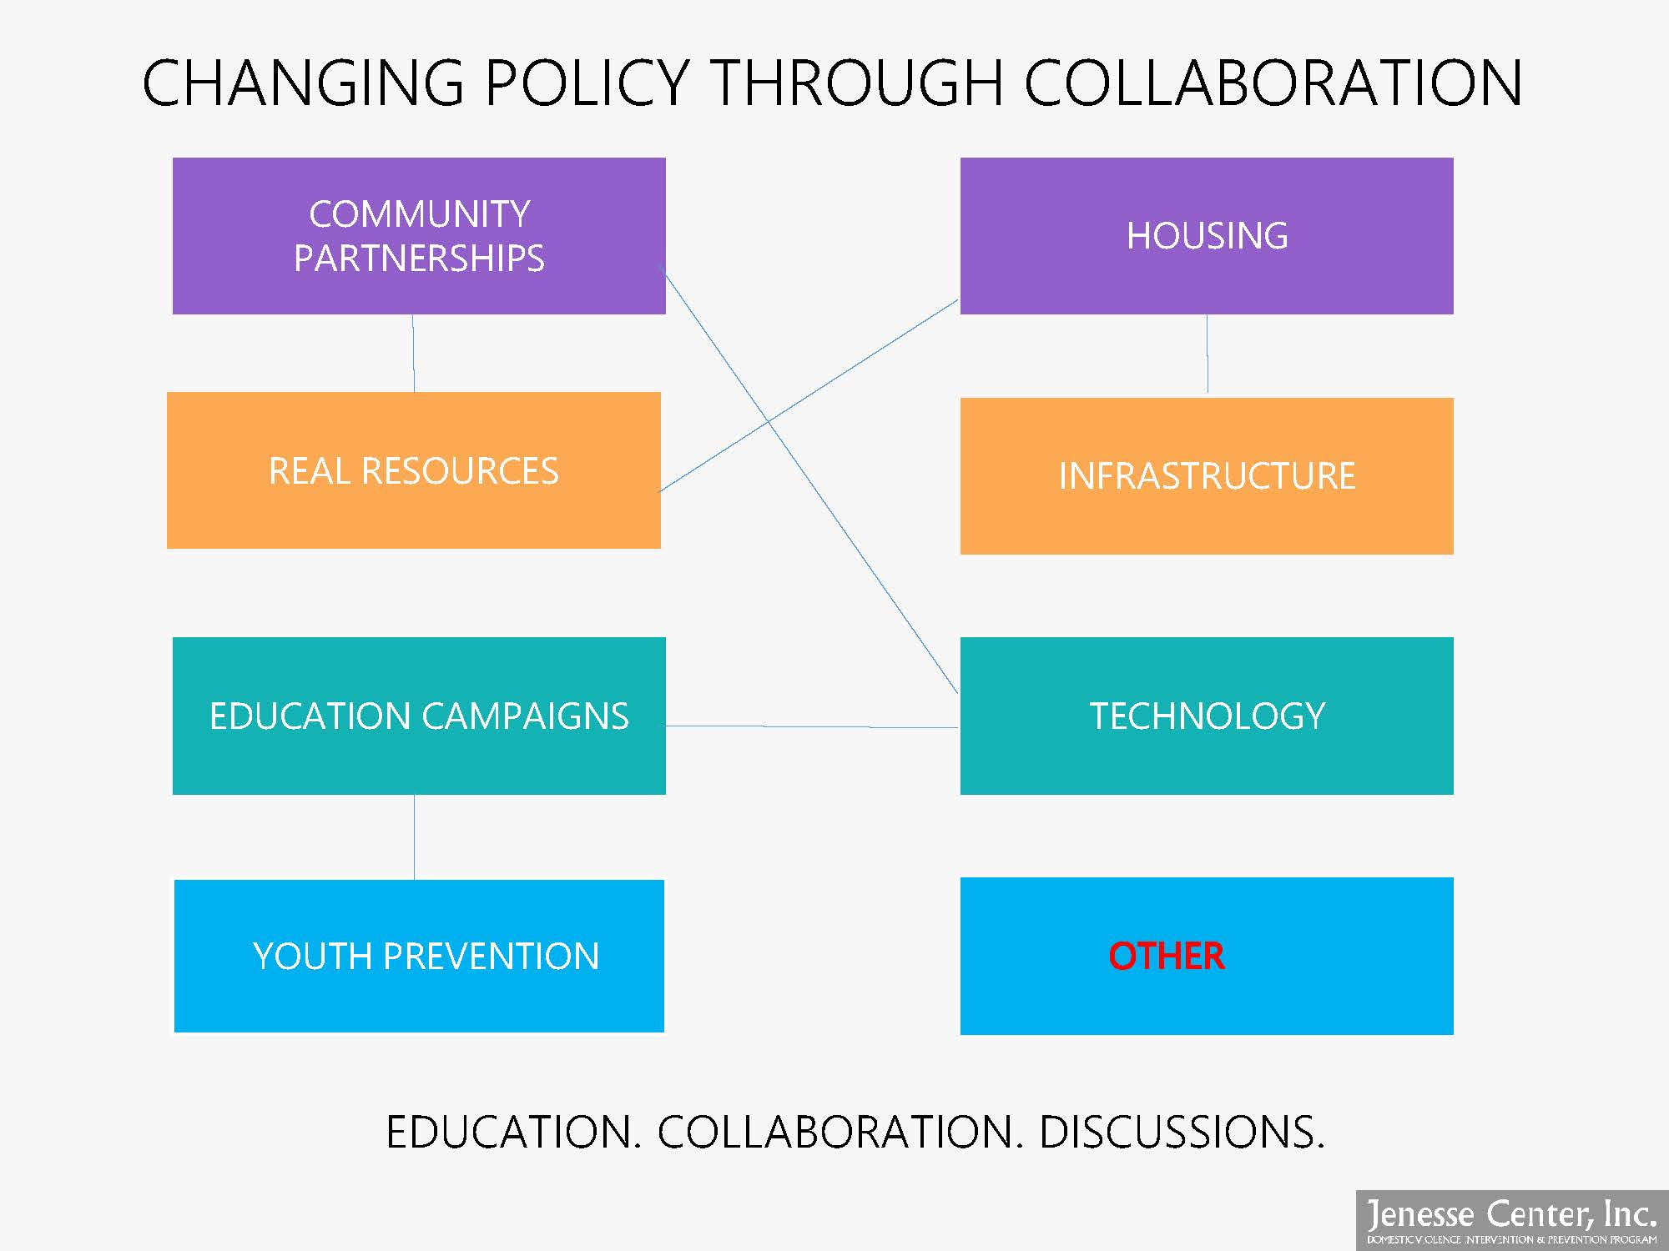
CHANGING POLICY THROUGH COLLABORATION
HOUSING
COMMUNITY
PARTNERSHIPS
REAL RESOURCES
INFRASTRUCTURE
TECHNOLOGY
EDUCATION CAMPAIGNS
YOUTH PREVENTION
EDUCATION. COLLABORATION. DISCUSSIONS.

Slide 42
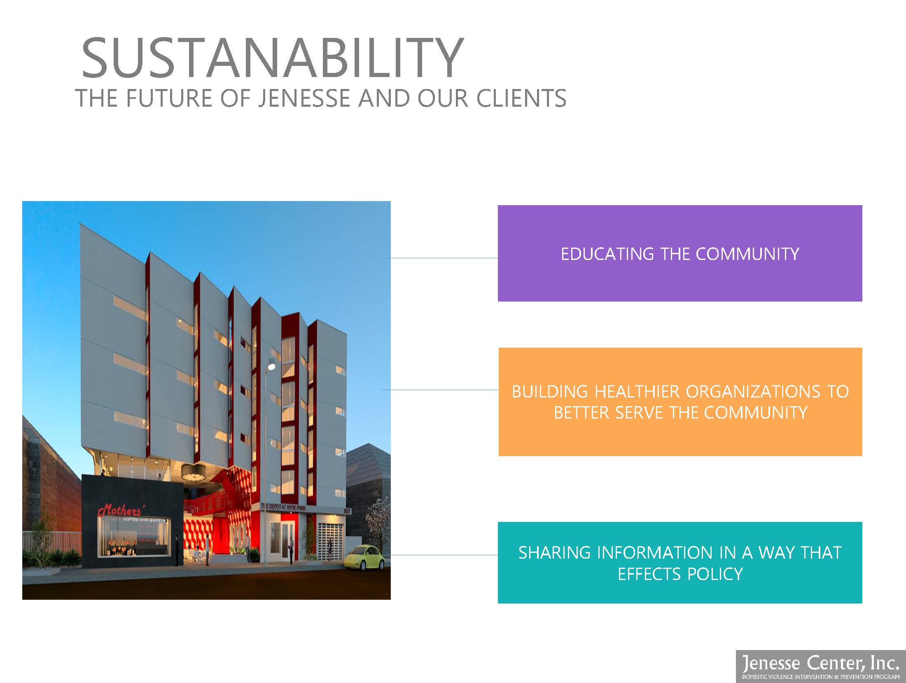
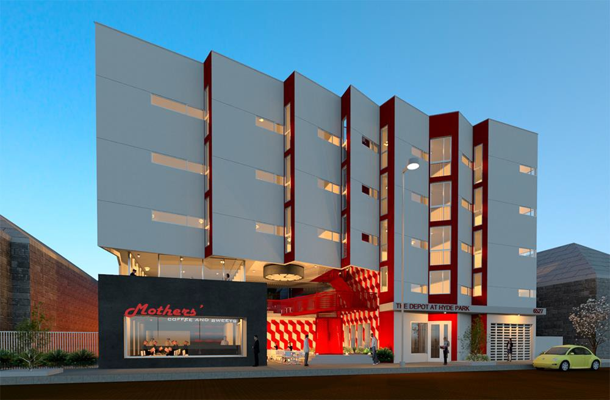
SUSTANABILITY
THE FUTURE OF JENESSE AND OUR CLIENTS
EDUCATING THE COMMUNITY
BUILDING HEALTHIER ORGANIZATIONS TO
BETTER SERVE THE COMMUNITY
SHARING INFORMATION IN A WAY THAT EFFECTS POLICY

Slide 43
Thank You.

Slide 44
Poverty and Opportunity
Stephanie R. M. Bray
President and CEO United Way California Capital Region
Notes:
Thank Kellie Todd Griffin and all who participated in the planning of the event
Timely given the current climate in this country when black women are reclaiming our bodies and our time and wielding our power to change and transform future generations.
When I started to the volumes of data gathered about us, I was hopeful for about a minute that we were making significant progress on a few fronts. More black women are insured. The number of Black women graduating from college continues to increase. We are starting more businesses. But…the data tells a story. A story about the history of racism and discrimination in this country. It would take us over 250 years to build the wealth that white people have today because of slavery and the Jim Crow era, and now, mass incarceration. But we endure, ladies, we endure. And that is why we are still here.

Slide 45
The Data Tells A Story
Percent of Women 18-24 Years Old with Health Insurance |  | Percent of Women with a Bachelor’s Degree or Higher Aged 25 and older |  | Percent of Women Living Below Poverty aged 18 and older
Black Women | All Women | Black Women | All Women | Black Women | All Women
84.4% | 80.4% | 32.8% | 31% | 23.8% | 15.7%

Slide 46
Key Findings
16.5 % of Black Women lack health coverage despite expansion of ACA; CA “the best third”
Black women have had the second largest improvement in attainment of higher education
The number of businesses owned by black women increased 178% between 2002 and 2012
Black Women experience poverty at a higher rate than black men and women from all racial ethnic groups except Native Americans
Notes:
For the 84% that do have health coverage, we still die from the most preventable causes of death at a much higher rate than any other ethnic group
However, we still tend to be employed in fields that pay lower wages
But, we still struggle because of barriers to like the inability to tap into networks that will enable us to grow our businesses
Because of inequities in education, workforce development, access to healthcare, affordable housing, childcare, and economic mobility, the poverty rate among black women of all ages continues to impact the vitality of our communities
This is not only a moral issue. According to Health Equity Now, a study of racial inequity in the Sacramento region that was released by PolicyLink just last week, this is an economic issue that in this region alone, contributes to a $29 billion dollar loss of economic opportunity.

Slide 47
Access to Health Insurance
ACA reduced the number of Black Women who are uninsured in California
However…
      Significant health disparities persist
      Access is a problem
      There is a lack of culturally competent care
Notes:
Before the ACA, almost 25% of black women were uninsured compared to 14% of white women. By late 2015, the rate of uninsured black women fell to 10.8 %
• Low-birth weight: The African American rate of 12% is twice the White rate of 6%.
• High infant mortality: African American infant mortality rates are more than 2.5 times greater than for Whites
Maternal mortality of black women is 26.4% compared to 7.3% for all other ethnic groups
• Suffer disproportionately from chronic diseases
Access to primary care is a problem—they might have solved the coverage issue, but there are folks here in Sacramento who cannot access the care available in their own neighborhoods
While African Americans represent 6% of California’s population, they represent only 3.2% of California’s physicians
Fund the replication of programs like the Black Child Legacy Campaign—Sacramento County committed $6 million dollars to reduce African-American Infant Child Deaths by much as 20% by the year 2020 and the pre-term birth initiative in the central valley
Examine the impact of geographic managed care on access
Invest in pipeline programs to increase the numbers of African American physicians and other health care professionals. Advocate for more community-based clinics in high-need areas to make primary care more accessible

Slide 48
Education
Key to breaking the cycle of poverty
However…
  There are financial barriers to full participation in higher education
  Racism and sexism
  Lack of role models
Notes:
The more education you have, the less likely that you will live in poverty. In fact, in CA, you are 64% less likely to live in poverty even if you have only two years of higher education compared to those with just a high school diploma.
Because of a lack of generational wealth and family support, Black Women take on more student debt than any other group and are three times more likely to default on student loans than white women. Gender and ethnic biases perpetuate a lack of leadership in academia which leads to a lack of role models.
Make sure that students are prepared by providing equitable access to high-quality preschool, an indicator of success in school. There are reasons why the grade-level literacy rate for CA students is so low—the lack of investment in pre-school for all, the fact that kindergarten is not compulsory.
Bring back and fund programs like Healthy Start that had strong outcomes
Continue the pressure on the State of California to fund the public higher education system to make college more accessible to greater numbers of CA’s students
Fund more scholarships that encourage black women to study STEAM fields
Institute student loan forgiveness for certain professions in high need populations like teachers or medical professionals to close the gender and racial gaps
Address hiring and promoting Black women faculty by requiring training on implicit bias throughout the public higher education system in CA
Invest in mentorship and internship programs that build leadership pipelines for young black women

Slide 49
Black Women Business Owners
Fastest growing segment of small businesses
However…
      Black women are the least likely to receive start-up capital
      Black women-owned businesses have the lowest average per business sales and receipts than any other group of business owners
Notes:
Because of racial and gender bias and discriminatory practices in hiring and upward mobility in the workplace, black women are starting businesses at a higher rate than any other ethnic group.
Inequitable access to capital inhibits growth of market share and the ability to compete in the market place.
Fund entrepreneurship programs with a specific focus on investment in black women-owned businesses
Ensure that any city, county or local contractors meet procurement clauses that provide equitable access to marginalized groups like black women AND
Create incentives for contractors to hire black women-owned businesses
Equal does not mean equitable—equal assumes that we all start from the same point with the same advantages; equitable means the removal of barriers that make it difficult for marginalized groups to compete. It means that black women should get more because we need it to correct generations of structural racism and sexism

Slide 50
Poverty and the Social Safety Net
Black women experience poverty across age groups at a higher rate than any other group
However…
      Black women who are eligible for benefits are often not accessing those benefits
      Black women do not earn equal pay for equal work
      Asset tests prevent low income families from building net worth through homeownership and savings
Notes:
More than three out of ten Millennials (31.5%) live below the poverty line
About one-fifth of black women aged 65 and older live below the poverty line
Ensure that SNAP, Temporary Assistance to Needy Families not only continue, but also educate and inform those who are eligible but not receiving those benefits
Preserve the CA EITC and continue to advocate for higher income thresholds so that more low income families qualify
EITC is still one of the most effective anti-poverty programs that has bipartisan support. Last year over 330,000 CA families received over $170 million in CA EITC refunds that were used to start businesses, pay down debt, purchase transportation to get to work, and move to better neighborhoods
Equal pay for equal work– that alone would cut the poverty rate for all working women in half according to the Institute for Women’s policy research
Get rid of the CalWORKS (CA Work Opportunity and Responsibility to Kids) asset test--max $2k in the bank if you are under 60yo and a car worth less than $9,500 A study done in 2015 by Howard University researchers show that the asset test provides a disincentive for families to save; forces families to use alternative financial institutions that cost them more; and it is a waste of taxpayer dollars because the amount of savings that CalWORKS recipients would have is less than the cost to administer the program

Slide 51
Sources
The Status of Black Women in the United States, National Domestic Workers Alliance
Black Women Deserve Better: Black Women and Girls Policy Agenda, Black Women for Wellness
Status of Women in California 2015, Institute for Women’s Policy Research
The Cost of Asset Testing for the CalWORKS Program, Tonya Brown-Robinson and Charlotte Otabor, Howard University Center On Race and Wealth, 2015

Slide 52
Thank You.

Slide 53
From Activist to Candidate
How to Run for Office – and WIN!
TED-Talk (Black Girl Magic) Style
Kimberly Ellis
Activist & Former Executive Director of Emerge

Slide 54
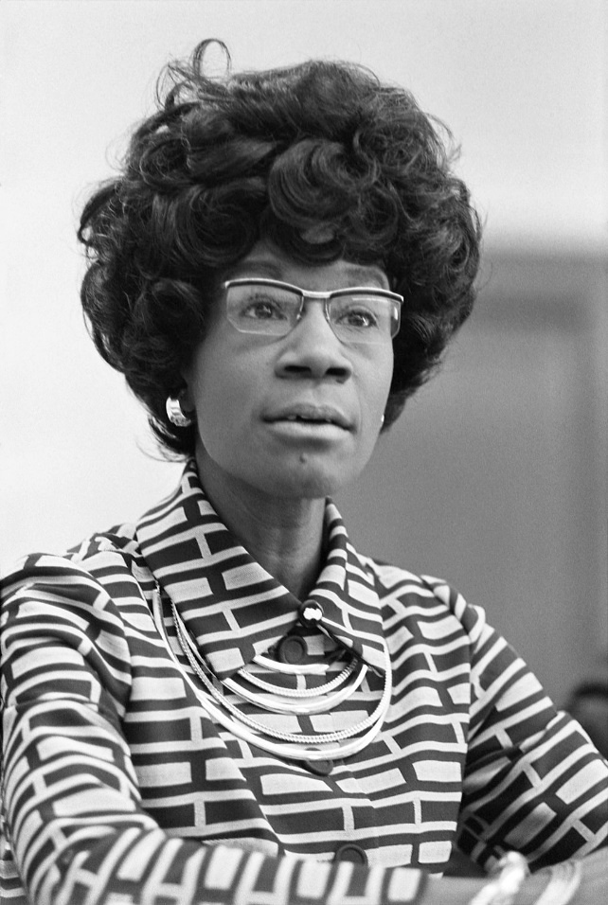
“At present, our country needs women’s idealism and determination, perhaps more in politics than anywhere else.”
-Shirley Chisholm

Slide 55
BY THE NUMBERS:
Black Women in Elected Office
Despite being 7.3% of the population… Black Women are only:
5% of officeholders elected to statewide executive offices, Congress and state legislatures
2% of the mayors in the nation’s most populous cities
Only 12 Black women have ever held statewide executive offices
Zero (0) Black women have ever been elected governor
Statewide, we are only:
2.5% in the California Legislature
Less than 3% on California Boards of Supervisors
0% of statewide Executive Offices
WE CAN AND WE MUST DO BETTER!

Slide 56
WHY (Black) WOMEN?
Because #PolicyMatters… and…
Because #WeMatter
Research shows that when women are at the decision-making tables, there is a positive shift in public policy that reflects commitment to issues and program that support not just women and children, but the entire community, including:
The economy
Quality healthcare
Criminal justice reform
Police accountability
Immigration reform
Childcare and elder care
Domestic violence prevention

Slide 57

Political Activism: Identifying Your Call to Service
Signing a recall petition
Gathering signature
Volunteering for a candidate
Volunteering for a political party
Volunteering for organized labor
Volunteering for advocacy organizations
RUNNING FOR OFFICE! ☺
Basically anything that furthers a candidate, an issue or a cause

Slide 58



3 Steps to Take BEFORE You Decide to Run
Discuss the idea with your FAMILY and FRIENDS
Do SELF-ASSESSMENT & PERSONAL INVENTORY
Identify your KITCHEN CABINET

Slide 59
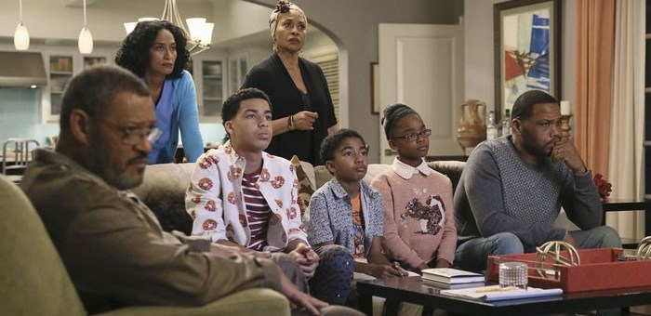
Discuss the Idea with Your Family and Friends

Slide 60
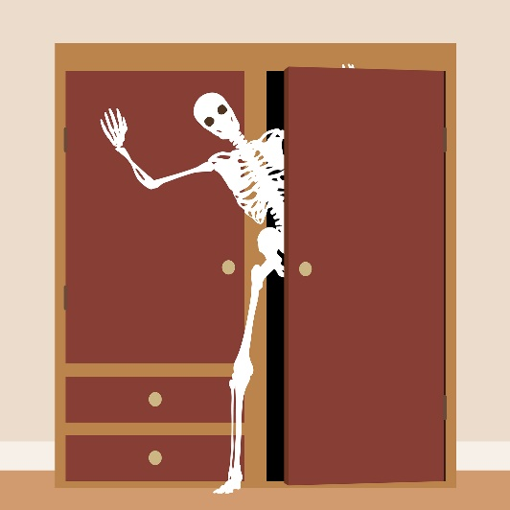
Do a Self-Assessment & Personal Inventory:
What’s in Your Closet?
If you put your name on the ballot, who will be your biggest detractors? Who will organize opposition to your candidacy?
What in your background could any opposition use against you?
Are there any issues with DUIs, bankruptcy or other legal or personal problems?
Will there be any surprises if we did a background check on you?

Slide 61
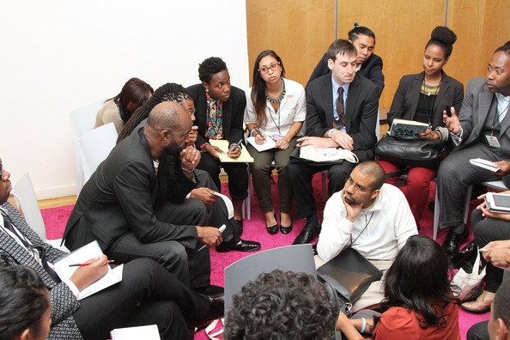
Identify Your Kitchen Cabinet

Slide 62


Ready. Set. GO!
After you have made the decision to move forward with your candidacy, in consultation with your family and kitchen cabinet, it’s now time to map out your road to campaign success.

Slide 63

Campaign Strategy 101: Lay of the Land
Contrary to popular opinion, campaigns are never about the candidates, they are always about the voters. They are not decided by which candidate is the smarter or more knowledgeable about the issues; they are decided by which one connects better on an emotional level with the voters’ current concerns and personal interests.
They are contextual, dependent on a particular time and place.
Therefore, the first step in the campaign planning and strategy process is to conduct a thorough Lay of the Land.

Slide 64
What’s Going On In the Hood?
You will need to know your district inside and out. and gauge whatever is going on that may influence how you and your opponent(s) are perceived as candidates.
Even if you have lived in your district your
entire life, you will need to take a fresh look
at this place and answer the following questions:
What is the current mood of the electorate?
What is the economic, cultural, political, and social climate like?
How have things changed here over the past 5-15 years?
What are people talking about at the local diners?
What is the character of this area like? What makes it unique?
Who are the largest employers and primary economic drivers?
Who are the current powerbrokers?
What are the current political dynamics and how might they help or hinder your election?
If there is an incumbent, how is s/he currently viewed?
What challenges and opportunities do you face as a candidate in this particular race in this particular time and place?

Slide 65

Persuadables: Moving the Middle
Many candidates believe that if you just talk to every voter, they can persuade all of them to vote for them. Sadly, that’s not how it works.
There will always be a set of people who are predisposed to vote for your opponent, a set who are already on your side, and a set who are up for grabs.
The key to victory is to identify – both geographically and demographically – who that group in the middle is, and which ones you can most easily move to your side to secure 52% on Election Day.

Slide 66

Message Development
Only after you have clearly assessed the Lay of the Land and defined your strategy can you start crafting your campaign message.
The seven “C’s” for an effective message are:
CLEAR – simple and easy to understand;
CONCISE – brief and to the point;
CONNECTED – relates directly to the local community and what is happening in this specific place and time;
COMPELLING – connects on an emotional or gut level (not just an intellectual one) and communicates a sense of urgency;
CONTRASTING – is something only you can claim and clearly distinguishes you from the other options;
CREDIBLE – is not only factual, but also rings true; and
CONSISTENT – is repeated over and over and over again throughout all campaign communication.

Slide 67

Why Do You Need a Strong Message?
Research show that the average American spends less than five minutes a week thinking about, talking about, doing something about politics, policy and government.
A good message needs to grab their attention quickly and efficiently, and to be communicated repeatedly in order to penetrate and persuade.

Slide 68

Developing Your Message
The most important questions that your message needs to answer or address include:
WHO are YOU?
WHAT do you VALUE?
WHY are you RUNNING?
HOW does it RELATE to your AUDIENCE?
WHAT will you DO for your COMMUNITY?
WHAT is the CURRENT political atmosphere?
WHAT is the NEXUS between your plans and the NEEDS of your COMMUNITY?
WHY are YOU the BEST person for the JOB?

Slide 69



The Message Box
WHAT YOU ARE SAYING ABOUT YOURSELF
WHAT YOUR OPPONENT(S) ARE SAYING ABOUT THEMSELVES
WHAT YOU ARE SAYING ABOUT YOUR OPPONENTS
WHAT YOUR OPPONENT(S) ARE SAYING ABOUT YOU

Slide 70

Tools Used to Communicate Your Message
Now that you have your message, how do you get it out there?
TRADITIONAL MEDIUMS
  Direct mail
  Television
  Radio
  Newspapers
  Brochures
  Magazines
  Word of Mouth
NEW MEDIUMS
  Social media
  Online blogs
  Listservs
  Online ads
  Email
  Text

Slide 71
Show Me the Money!
Now that you’ve formulated your campaign strategy and defined your message, it’s time to figure out how you’ll fund your efforts.

Slide 72
Plan to WIN
Running a campaign will costs money. The higher the office, the more money you will have to need to raise.
Determine how much money it will take to fund all of the activities and components of the campaign, including:
Paid campaign staff
Communication efforts, like direct mail
Volunteers
Campaign headquarters
Once you’ve added everything up, it’s time to draft a campaign budget and a corresponding fundraising plan to meet that budget.

Slide 73
Fundraising 101
Fundraising is kinda like going to the dentist
For some candidates it’s the hardest part of their job
With preparation and organization, fundraising
can be a positive experience
Fundraising is not charity; it’s not begging
It’s not a favor and it’s not a personal gift
Donors contribute when it benefits THEIR OWN NEEDS

Slide 74
Where Will the Money Come From?
There are four main groups from which you will do the majority of your fundraising. Be prepared to make a master list and assign all of your contacts to one of these buckets.
Personal circle – people who love you and aren’t allowed to say no, like your mom and grandpa. This money is also referred to as your “love money” or “early money”
Ideological circle – these are folks who are cause driven and share your same passion for an issue
Ax to grind – these are people who don’t like your opponent and don’t want them to win
Power circle – these are the usual suspects, the heavy hitters like major donors, developers, and labor unions

Slide 75
Select Your Fundraising Tools
After you’ve put together your master list or database, organized your contacts into categories, estimated their capacity, researched giving history, assessed the depth of the relationship to the candidate, it’s time to select the precise tools you will use for each category of donors.

Slide 76

Use a Tiered- Approach
Time is the candidate’s most treasured commodity and it’s critically important to remember the rule of infinite resources. Use your time wisely to maximize your fundraising efforts.
CALL TIME – usually reserved for high donors, personal
calls or 1:1 meetings with the candidate
EVENTS – to event or not to event, that is the question! Fundraising events are a means to an end, focus on the money and don’t get lost in the attendance or logistics
DIRECT MAIL – There is no other medium that can deliver
your targeted message more precisely, and just about everyone
has an address

Slide 77
RECAP: Piecing It All Together
IDENTIFY your call to service
ANSWER your call with courage
Discuss the idea of running for office with your FAMILY and FRIENDS
Do a SELF-ASSESSMENT & PERSONAL INVENTORY
Identify your KITCHEN CABINET
Conduct a LAY of the LAND
DEVELOP your message
Put together a BUDGET
Raise the MONEY
COMMUNICATE your message
BUILD 21st century networks
CULTIVATE networks
COMMIT to service
KNOW your community
BUILD leadership teams
CONNECT with people
MOBILIZE to win

Slide 78
IMMEDIATE Steps You Can Take to Prepare to Run for Office
VOLUNTEER on a campaign
GET APPOINTED to a board or commission
SUPPORT other (Black) women candidates with financial contributions
ASK other (Black) women to consider running for office
CONSIDER applying to the EMERGE CALIFORNIA, BWOPA, or similar political training programs

Slide 79
Please Consider Running for Office.
WE NEED YOU!
There are more than 500,000 elected and appointed positions in the United States.
There is a position just right for YOU!

Slide 80
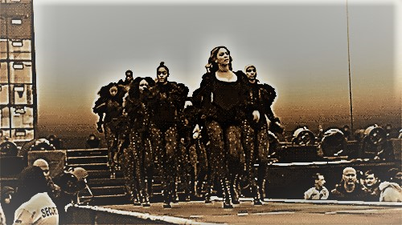

Ok Ladies, Now Let’s Get In Formation!

Slide 81
Employment & Earnings
Sandra Davis Houston
Vice President Human Resources
Dignity Health

Slide 82
State of Black Women Forum
Sandra Davis Houston
Vice President, Human Resources GSSA
Dignity Health
March 14, 2018

Slide 83
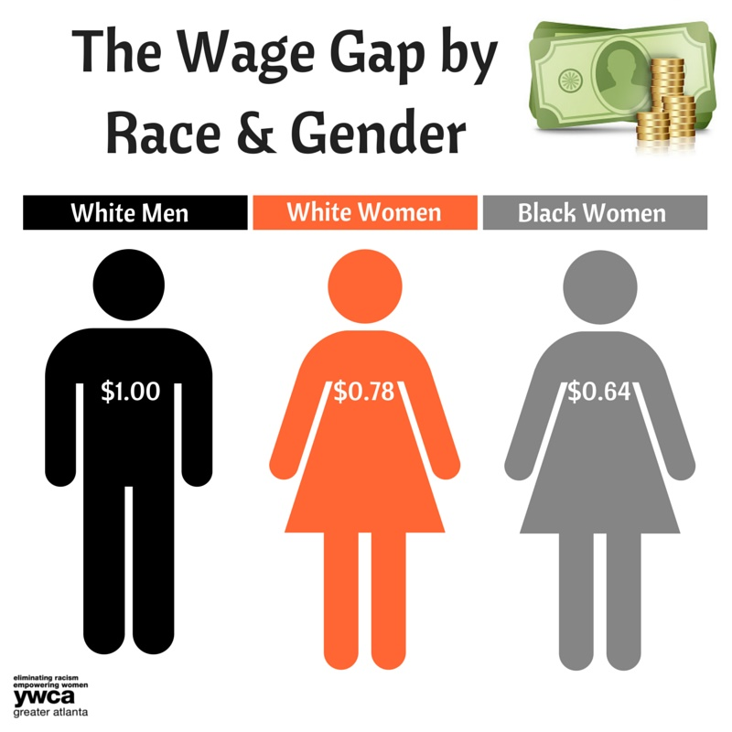
Wage Gap
$0.76
$0.63
According to the National Partnership for Women & Families,
Black Women & the Wage Gap, March 2017 Fact Sheet

Slide 84
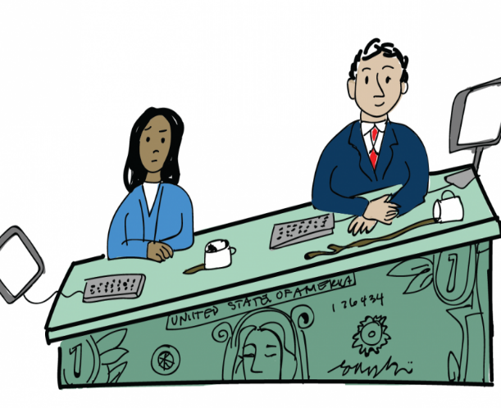
Wage Gap
Median Wages for White Non-Hispanic Men in California is $70,805
Median Wages for White Women in California is $53,731
Median Wages for Black Women in California is $44,680
Cents on the Dollar for Black Women is 0.63
This equals a wage gap of $26,125 each year

Slide 85

How Does the Wage Gap Harm Black Women?
Nearly 2.5 more years of child care
Nearly 2.5 additional years of tuition and fees for a four-year public university or full cost of tuition and fees for a 2 year community college
155 more weeks of food for her family (3 years)
14 more months of mortgage and utilities
Nearly 22 more months of rent

Slide 86

Where Do We Go From Here or What Role Can We Play?
Legislative Sector
Create and support legislation to increase the minimum wage
Socialize the issues around pay, the wage gap and equity for Black Women

Slide 87
Where Do We Go From Here or What Role Can We Play?
Workplace
Conduct market analysis on positions annually, include analysis of the impact on women
Include a diverse slate of candidates for open positions
Educate hiring managers on the importance of a diverse staff
Partner and sponsorship of national and local organizations and Boards

Slide 88
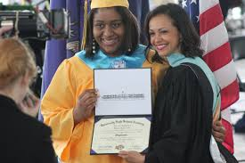
Where Do We Go From Here or What Role Can We Play?
Workplace
Encourage diversity, inclusion and belonging initiatives
Implement formal mentoring programs
Develop formal Sponsorship programs
Create internships and educational scholarships

Slide 89

Where Do We Go From Here or What Role Can We Play?
Personal
Participate in mentor programs
Coach and sponsor Black Women and Black Girls
Create opportunities for advancement of Black Women
Volunteer in the community
Model professional and inclusive behaviors
Step out of your comfort zone

Slide 90
Thank You

Slide 91
Work & Family
Dr. Robin Carter
Associate Dean, Health & Human Services
Sacramento State Universary

Slide 92

Black Women & Work
Dr. Robin Carter

Slide 93
Factors that Affect Black Women in the Workplace
Stereotypes
Access Discrimination
Evaluation & Promotion Bias
Job Leaves
Sexual Harassment
Affordable day care
Limited PTO
Incarceration of mothers
Unemployment
Occupational Segregation
Pay Disparities

Slide 94

Workforce Participation
58.4% in the labor force
More than two-thirds of all Black working mothers are single mothers
80% of all Black women are breadwinners in their families
23.2% in service occupations
72% of part-time workers are female.

Slide 95
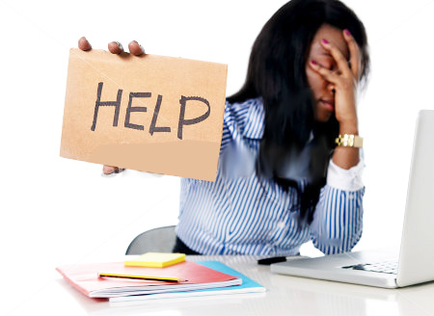
Workplace Participation
3 women in 5 work at or below the minimum wage.
1 in 2 people who work more than one job are women.
1 in 2 working women provide half or more of their household income.
7 in 10 married working mothers work more than 40 hrs/week.
3 in 10 working women work evenings, weekends, or some combination.
More than 58% of workers paid by temp agencies are women.

Slide 96
Black Women Leading
Median average earnings – full time-year round- $43,000 vs. $42,000 for all
Ratio of earnings between women and white men – black women 62.3- white women 60.9
Percentage of women in managerial or professional occupations –black women 38.8 all women 39.8
Some of the most highly educated in the workforce
Own businesses at a higher rate than other groups

Slide 97
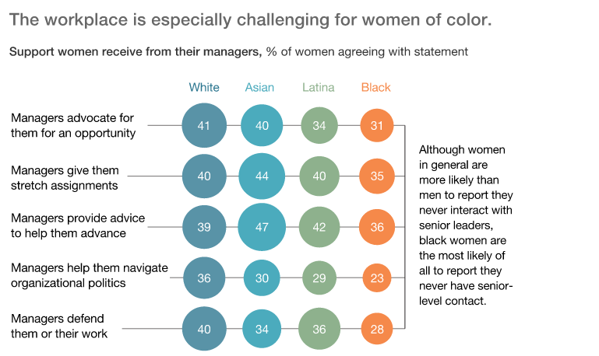

Slide 98
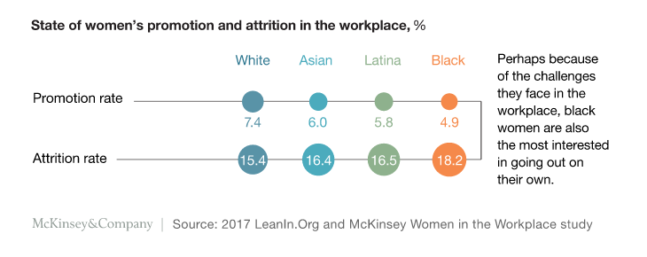

Slide 99

New California Workplace Legislation
Salary History
Ban the Box
New Parental Leave Act
Retaliation
Anti-Harassment Training
Paid Sick Leave

Slide 100
Opportunities for Activism and Policy Development
An Increase in Diversity of Boards of Directors
More women in leadership roles
More funding for entrepreneurs
More women in STEM
Stronger systems for reporting sexual harassment
More male allies

Slide 101

Changing the Narrative
Moving away from male centered narratives about work
Changing the basic organizing principles that govern workplace practice
Acknowledging black women’s role in the economic development of California
Engaging black men in our struggle and success

Slide 102

Family Friendly Workplace Initiatives
Affordable day care – Women in California spend 27% of their income on daycare
Family friendly options such as job sharing, telecommuting
Support and protect caregivers in the workplace (San Francisco Family Friendly Workplace Ordinance)

Slide 103
Opportunities for Advancement
Tuition Reimbursement
Mentorship
Paid Internships
Address Bias and Discrimination in the workplace
Leadership Development

Slide 104
Increasing Opportunities for Economic Security
Equal Pay
Financial literacy education
Retirement benefits with employer matching
Profit sharing
Benefits for part time employees

Slide 105

Thank You…

Slide 106
Let’s Break…

Slide 107
1st Break Outs
Kindra Montgomery Block
Senior Program Officer
Black Child Legacy
Cassandra Jennings
President & CEO
Greater Sacramento Urban League

Slide 108
1st Break Out Session
Health & Wellness
Violence & Safety
Poverty & Opportunities

Slide 109
Lets Talk About That…
Lunch Conversation hosted by
Kathy Williams
Communications Director
Assemblyman Mike Gibson

Slide 110
Conversation on Leading through Change Past to Present
Elika Bernard
Black Women United
Dezie Woods-Jones,
Black Women Organized for Political Action

Slide 111
1st Break Out Session Report Out
Health & Wellness
Violence & Safety
Poverty & Opportunities

Slide 112
2nd Break Outs
Kindra Montgomery Block
Senior Program Officer
Black Child Legacy
Cassandra Jennings
President & CEO
Greater Sacramento Urban League

Slide 113
2nd Break Out Session
Political Participation
Employment & Earning
Work & Family

Slide 114
2nd Break Out Session Report Out
Political Participation
Employment & Earning
Work & Family

Slide 115
Next Steps
Kellie Todd Griffin

Slide 116
Thank Yous…
Kim Williams
Kendra Lewis
Stephanie Bray
Nolice Edwards
Dr. Ramona Bishop
Sandra Poole
Kathy Williamson
Dr. Angela Wells
Cassandra Jennings
Kindra Montgomery-Block
Christi Ketchum
Kula Koenig

Slide 117
Reception
Pearl on the River
1379 Garden Hwy
Sacramento, CA 95833
6 p.m. – 9 p.m.

Slide 118
Thank you….

